Slide 1
Better off? Distributional comparisons for ordinal data about personal well-being
Stephen P. Jenkins
LSE
Email: s.jenkins@lse.ac.uk
Research partially supported by the core funding of the Research Centre on Micro-Social Change at the Institute for Social and Economic Research by the University of Essex and the UK Economic and Social Research Council (award ES/L009153)

Slide 2
Motivation / background
How to undertake distributional comparisons when personal well-being is measured using income is well-established …
But what if personal well-being is measured using subjective well-being indicators such as life satisfaction or self-assessed health status?
Has average well-being increased or well-being inequality decreased in New Zealand? How does the distribution of well-being in New Zealand compare with that in Australia? And so on
Increasing weight is being put on subjective well-being measures by international agencies such as the OECD and national governments including New Zealand’s
Making distributional comparisons using subjective well-being measures raises analytical challenges because we have ordinal measures rather than cardinal ones (‘income’)

Slide 3
Outline of talk
Introduction to the analysis of ordinal measures of personal subjective well-being (SWB):
Some preliminaries
Benchmark: methods for comparing distributions of income to assess whether we are ‘better off’
Levels (and % of people with low, high values); inequality
An analogous ‘toolbox’ for comparing SWB distributions
Empirical illustrations using data about NZ from the World Values Survey (WVS)
Life satisfaction (‘LS’)
Self-assessed health status (‘health’)
Lessons to be drawn

Slide 4
1. Some preliminaries
Cardinal/ordinal, etc.
Well-being and NZ

Slide 5
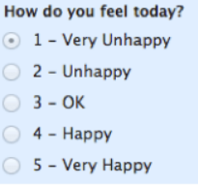
Cardinal versus ordinal measures
Cardinal (e.g. income)
Order of values, and absolute differences between values are well-defined, and so too are ratios of values because a value of zero is well-defined
Ordinal (e.g. life satisfaction and other subjective well-being measures)
Order of values is well-defined, but not differences in magnitude (or ratios)
We don’t know if the difference in happiness between ‘OK’ and ‘Happy’ is the same as the difference between ‘Happy’ and ‘Very Happy’
The labels [1,2,3,4,5] are arbitrary; could be [1,2,3,5,10]; or [–4, –2, 0, 2, 4]; or …

Slide 6
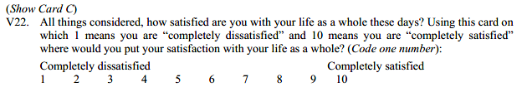
WVS Life Satisfaction question
10 point scale:
What would you respond?
Remember your answer and compare it with the estimates shown later

Slide 7

WVS Health question
Self-assessed health question (wave 5):
Responses are reverse-coded here: I give ‘Very good’ the highest code
NB a “Very poor” category was used in earlier WVS waves (and in error for ZA in wave 5)
What would you respond?
Remember your answer and compare it with the estimates shown later

Slide 8
Well-being to the fore in NZ

Slide 9


Well-being: a strategic priority in NZ
z

Slide 10
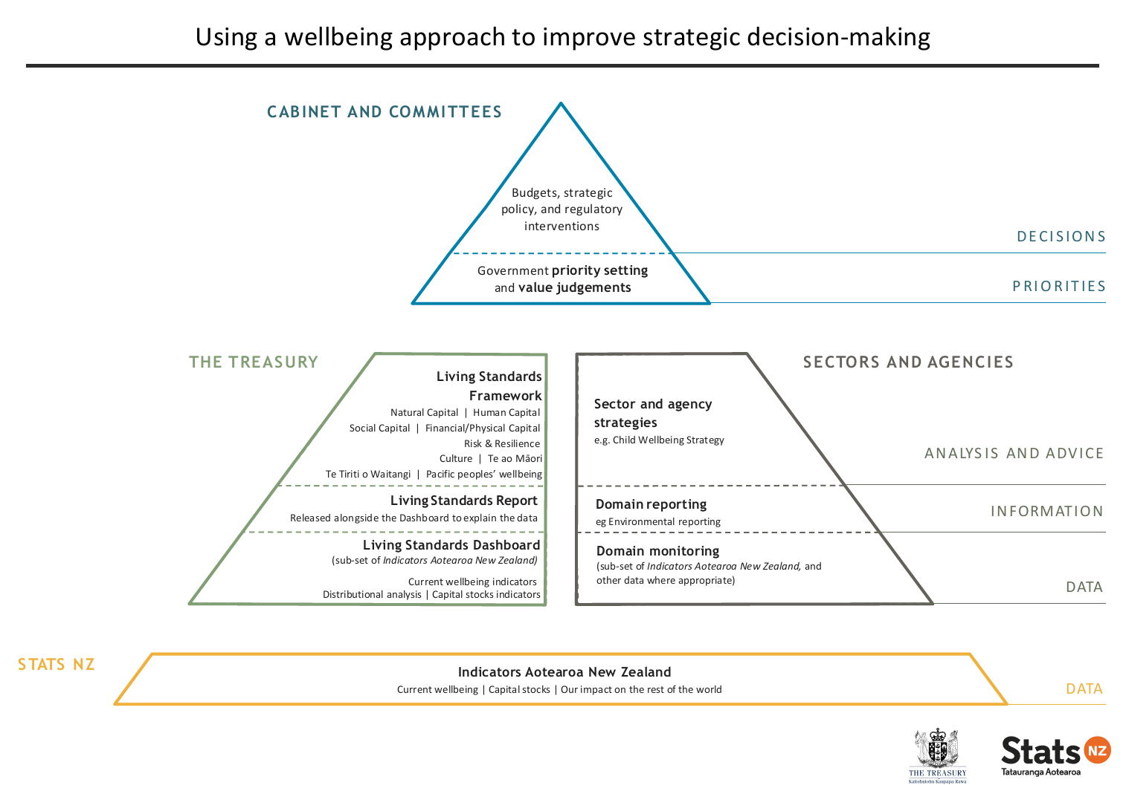
Government, NZT, and Stats NZ

Slide 11
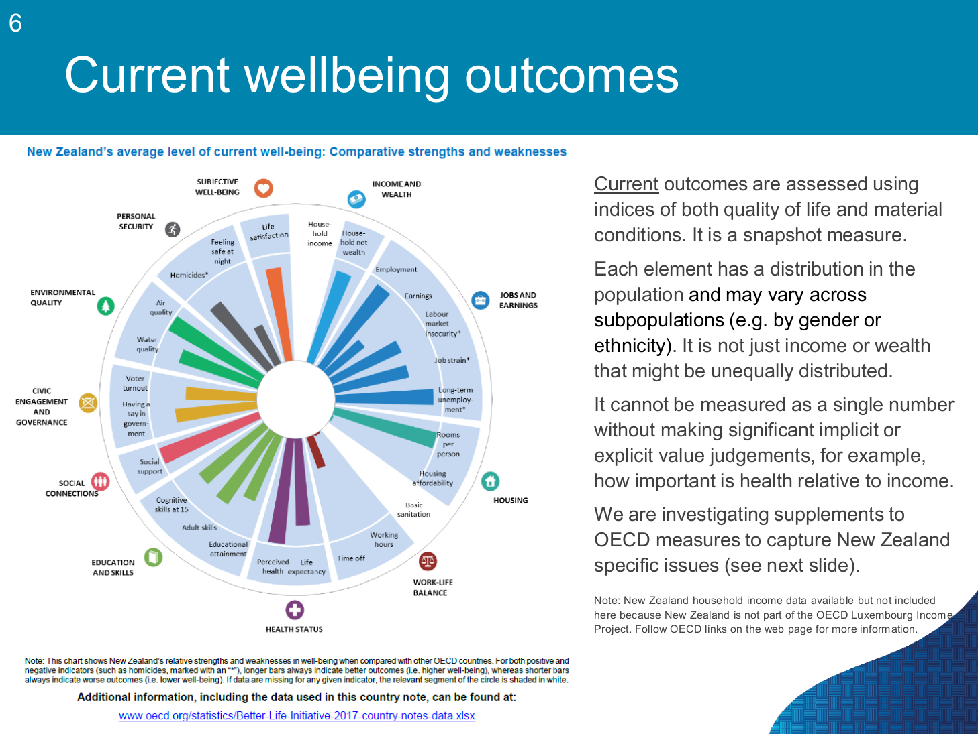

Well-being and NZT’s Living Standards Framework

Slide 12

“Worked examples of how the LSF Dashboard can be used for policy analysis can be found here” (2019-05-18)
https://treasury.govt.nz/publications/guide/living-standards-framework-worked-example-macro-micro
!

Slide 13
Caveat
This talk is about assessing social progress – monitoring the (distribution of) well-being outcomes per se
Are we better off, in well-being terms?
This talk is not about the relationships between these outcomes and policy interventions
How can and will the Living Standards Framework and well-being approach be used to guide policy design and analysis?
NZ (and elsewhere) need to know about both aspects!
But you cannot do the second task properly without the first one sorted out

Slide 14
2. Assessing ‘better off’: distributional comparisons for income data
A benchmark ‘toolbox’
– are there corresponding methods
for ordinal data?

Slide 15
Standard methods for income data
Two main outcomes of ‘social welfare’ interest: income levels (including mean; poverty), and inequality
Two main approaches in the assessment toolbox
Pictures: to show the data and to conduct ‘dominance’ checks
Dominance: can we rank distributions A and B using only minimal assumptions about the social welfare function?
Indices: to summarise numerically
Ranking distributions when dominance does not hold (so stronger assumptions required about social welfare function)
Providing magnitudes, not simply orderings

Slide 16
The power of pictures
Density functions: to show the data
Levels and Cumulative Distribution Functions (CDFs)
CDF: F(x) = p, p ∈ [0,1]
Alternatively: compare Pen’s Parades (quantile functions): x = F^{–1}(p)
To show the data and undertake first-order dominance checks
Inequality and Lorenz Curves
To show the data and undertake dominance checks

Slide 17
CDFs and distributional comparisons
Link configurations of CDFs with first-order Welfare dominance and with Poverty dominance
Suppose that the social welfare function is W = W(x₁,x₂,…,x_{n})
Class W ₁ characterized by all W that satisfy properties:
More is better, other things equal (‘Pareto’ principle, a.k.a. monotonicity)
increasing (∂W/∂x_{i} > 0, all i), or at least non-decreasing
All that matters is the value of your ‘income’ (so ‘anonymity’)
Symmetric, i.e. invariant to permutations of the income vector
We can compare distributions from populations that are of different sizes
Invariant to replications of the population
NB W ₁ is essentially concerned with real income levels

Slide 18
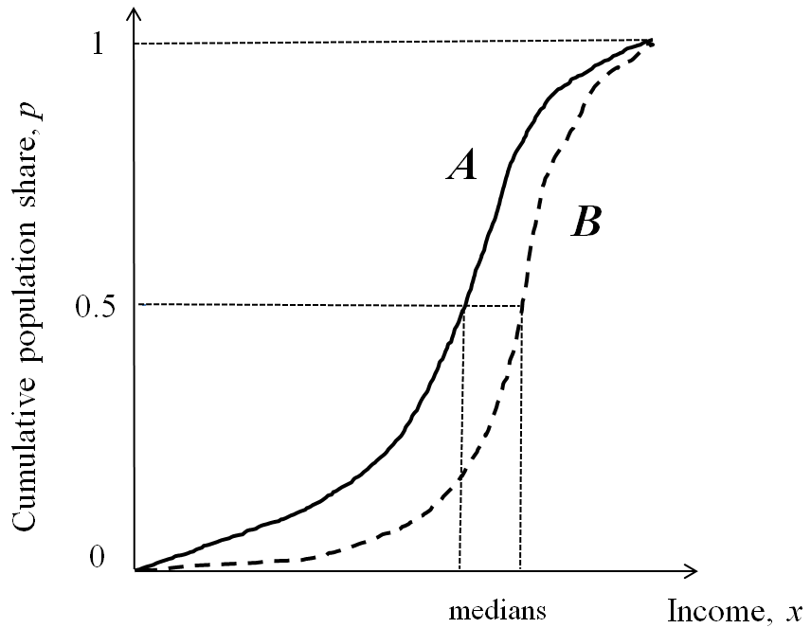
CDF and dominance (a)
First order welfare dominance result (Saposnik):
CDF(B) lies everywhere below CDF(A) ⇔ W(B) > W(A) for all W ∈ W ₁ , i.e. symmetric replication-invariant social welfare functions increasing in each income
Distribution B is better than A in a social welfare sense
At any specific p, quantile x = F^{–1}(p) is larger in B than A
Mean(B) > Mean(A)

Slide 19
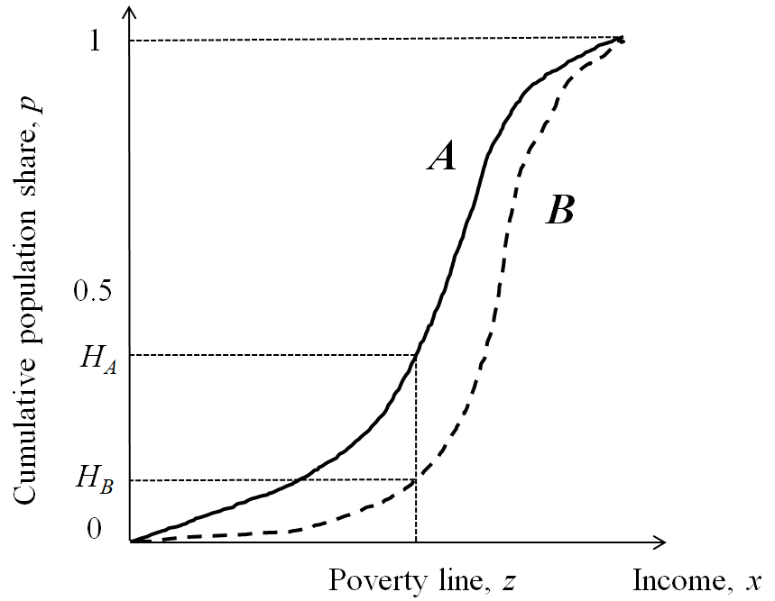
CDFs and dominance (b)
Poverty dominance according to the Headcount Ratio measure, H, a.k.a. the proportion poor (Foster & Shorrocks)
If CDF(A) lies everywhere above CDF(B) at every income in interval [0, z], then H(B) < H(A) for all common poverty lines between 0 and z
Analogous results for proportions above a threshold

Slide 20
Lorenz curves and inequality
A Lorenz curve plots cumulative income shares against cumulative population shares (p), with obs in ascending order by income
Complete equality: Lorenz curve coincides with 45° ray through origin
Inequality is greater, the further the Lorenz curve from the 45° ray
Gini index of inequality equals twice the area between the Lorenz curve and the 45° ray

Slide 21
Lorenz curves and inequality comparisons
Class of social welfare functions, W ₂ with W ∈ W ₂ if increasing in each income (i.e. respects more is better), symmetric, replication-invariant and concave (i.e. respects equality preference)
This means that a mean-preserving spread of income lowers social welfare ≈ ‘inequality aversion’ ≈ ‘equality preference’
E.g. a transfer £10 from a poor person to a millionaire reduces overall societal welfare
And vice-versa: a mean-preserving transfer from a rich person to a poor person raises overall societal welfare
Example of function satisfying W ₂: w = ∑_{i} U(y_{i}), with U(y_{i}) = log(y_{i})

Slide 22
A mean-preserving progressive transfer shifts the Lorenz curve inwards (inequality reduction)
The Poorer person has a bit more income; Richer person has a little less, all other incomes and total income unchanged
So cumulative income shares above cumulative population shares corresponding those between Poorer and Richer must be greater , i.e. Lorenz curve moves inwards over range between Poorer and Richer
P
R

Slide 23
Lorenz curves and inequality dominance
Atkinson (1970) theorem [also Kolm]:
For 2 distributions with the same mean, if the Lorenz curve for distribution x lies above the Lorenz curve for y ⇔ W(x) > W(y) for all W ∈ W ₂ , i.e. symmetric replication-invariant increasing and concave social welfare functions
This is a result about inequality comparisons for distributions in which one ‘controls’ for differences in mean income
by deflating every income by the mean of the distribution to which it belongs, the two distributions being compared have the same mean (equal to one)

Slide 24
Inequality comparisons, UK incomes: 1981, 1985, 1991

Slide 25
Inequality indices often used with income data
Gini index, G
Generalised Entropy indices, GE(a), including
GE(0): mean logarithmic deviation
GE(1): Theil
GE(2): half the squared coefficient of variation
Larger a ~ more ‘top sensitive’; smaller a ~ more ‘bottom sensitive’
Atkinson indices, A(e)
Parameter e: degree of inequality aversion
Larger e: more inequality-averse ~ more ‘bottom sensitive’
All the indices are forms of social welfare functions defined over a distribution of relative incomes, where relative income = income ÷ mean
All indices incorporate normative assumptions

Slide 26
3. Well-being comparisons for ordinal variables
Most SWB aficionados treat well-being measures as if they are cardinal rather than ordinal

Slide 27
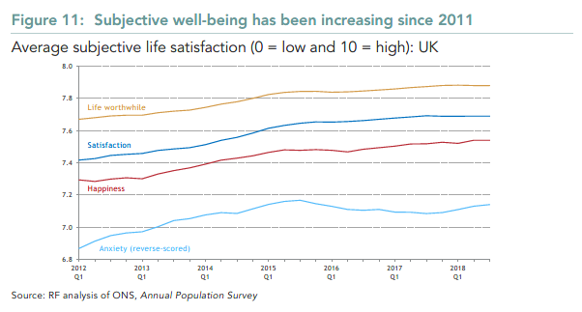
Tracking well-being: averages over time (UK)
Source: G Bangham (2019), Happy now? Lessons for economic policy makers from a focus on subjective well-being, Resolution Foundation.

Slide 28
The mean is not order-preserving under scale changes (Allinson-Foster, JHE 2004)
Cardinal data: the mean is a stable reference point of the distribution
Ordinal data: any re-scaling is possible, and the mean’s location relative to the distribution (or subset of observations) can vary widely with changes in scale
E.g. distribution x = (1,3,3,6,4) with scale c = [1,2,3,4,5] has mean μ(x, c) = 3.53, located between 7th lowest and 8th lowest of 17 obs
But if instead scale c′ = [1,2,3,4,8], μ(x, c′ ) = 4.24, lying between 13th and 14th of the 17 obs
“Recalling the categorical nature of the original data, it is difficult to accept the notion of a central reference value that jumps across observations and values with such ease” (Allinson & Foster 2004: 510)
Non-robust answers to “What percentage of population has above-average SWB?”
Ordinal data: ranking of 2 distributions by the mean may change when scale changed
E.g. distribution x = (2,2,2,2,2) and y = (3,2,1,1,3): with scale c = [1,2,3,4,5], mean μ(x, c) = 3 > μ(y, c) = 2.9. But if c′ = [1,2,3,4,10], μ(x, c′ ) = 4 < μ(y, c′ ) = 4.4, i.e. reversed ranking
Allinson & Foster (2004) have a real world example using self-assessed health data
Potential objection: scales for Life Satisfaction variables are sufficiently familiar that they do have intrinsic meaning [?]

Slide 29
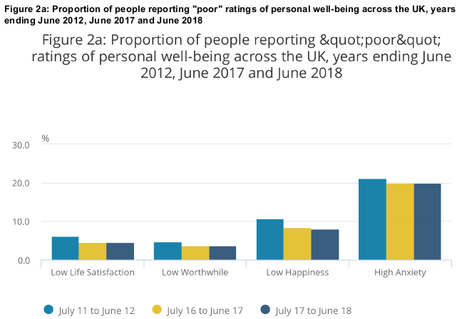
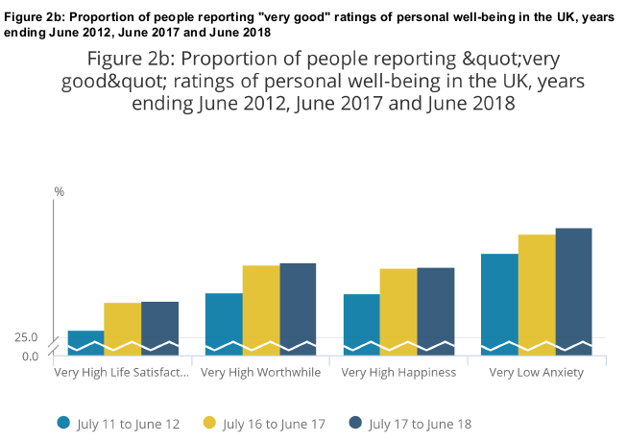
Tracking well-being: proportions with low and very high SWB levels (UK)
Note: “Poor” well-being refers to those providing life satisfaction, worthwhile, and happiness ratings of 0 to 4 on an 11-point scale, and anxiety ratings of 6 to 10. 'Very good' well-being refers to those providing a rating of 0-1 for anxiety and 9-10 for happiness, life satisfaction and worthwhile.
Source: ONS, Personal Well-being in the UK, July 2017 to June 2018, 2018

Slide 30
Distributional orderings based on comparisons of CDFs are robust to changes in the scale
The ONS’s charts of trends in the fraction of people with ‘poor’ (or with ‘very good’) SWB are based on comparisons of points on the CDFs
If the distribution for Year 1 has a smaller (larger) fraction of people with ‘poor’ SWB than does the distribution for Year 2, changing the scale does not change the result
Scale [0,1,2,3,4,5,6,7,8,9,10] with ‘poor threshold ‘4’ and scale [-5,-4,-3,-2,-1,0,1,2,3,4,5] with ‘poor threshold ‘-1’ would provide same fractions for the distributions in Years 1 and 2
Hence strong case for placing comparisons of CDFs at heart of analysis of ordinal data

Slide 31
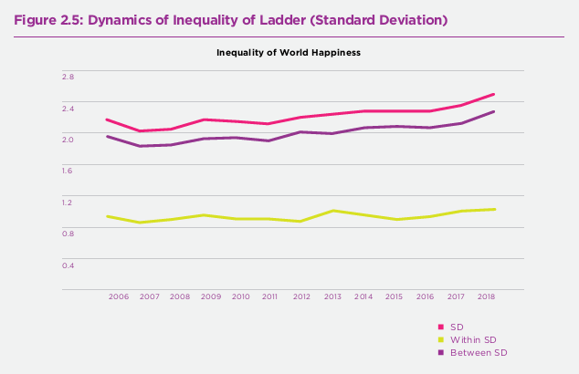
Tracking well-being: inequality over time
Note: “inequality” is measured using the standard deviation of the SWB score
Source: Helliwell, Layard, and Sachs (eds), World Happiness Report 2019

Slide 32
Standard inequality indices should not be applied to ordinal data
Bounded scale means that secular increases in SWB mechanically reduce the standard deviation (SD)
Two distributions with quite different tails may (wrongly) get attributed with the same inequality
Inequality orderings based on the SD and other ‘absolute’ measures (e.g. absolute Gini) don’t change if each scale value is changed by the same amount, e.g. if c = [1,2,3] → c′ = [3,4,5]. But why this transformation only – why rule out others?
Inequality orderings based on standard relative measures (as earlier) are not robust because the indices depend on ratios of incomes to the mean, and the mean is not order-preserving with changes to the scale

Slide 33
Inequality and ordinal data
Fundamental questions to be addressed:
What is the ‘perfect equality’ benchmark?
Everyone gives the same response (all in same category)
Dispersion in ‘location’ relative to what reference point?
Not the mean!
What is the ‘perfect inequality’ benchmark?
‘More unequal’ is characterised how?
Cf. mean-preserving spread in traditional (Lorenz-based) approach
Issues 2–4 not fully resolved yet
Dominant approach among economists to date is to: take the median as the reference point; interpret ‘more unequal’ as greater dispersion around the median; and thence interpret ‘perfect inequality’ benchmark as being when half the responses are in lowest category and half in the highest
NB strictly speaking, given the perfect inequality benchmark, this approach summarises polarisation, rather than inequality

Slide 34
Median-based approaches to inequality of ordinal data (Allison & Foster, JHE 2004)
Relative position of the median doesn’t change if the scale changes
Inequality as ‘greater spread away from the median’: Allinson & Foster’s S-dominance concept
Given two distributions x and y, x has greater spread than y if:
Distributions x and y have the same median m; and
for all categories k < m, cumulative population share of lowest k categories of x ≥ cumulative population share of lowest k categories of y; and
for all categories k ≥ m, cumulative population share of lowest k categories of x ≤ cumulative population share of lowest k categories of y
See over for graph contrasting S-dominance with F-dominance
‘F-dominance’: when CDFs don’t intersect (and ordering of means robust to scale)
Cf. Lorenz-dominance: ‘greater spread away from the mean’

Slide 35
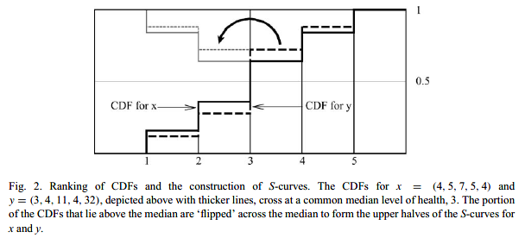
Median-based approaches to inequality of ordinal data (Allison & Foster, JHE 2004)
Distribution x has greater inequality than y: CDF(x) ≥ CDF(y) below the median category, and CDF(x) ≤ CDF(y) at median category and above (and common median)
more of mass is concentrated in the extremes, unambiguously further away from the median

Slide 36
Inequality (polarisation) indices consistent with the median-based approach
Allison-Foster (2004) and Dutta-Foster (RIW, 2013): mean level of SWB above the median minus mean level of SWB below the median
Scale-dependent but ‘gap’ idea is easily grasped
Abul Naga & Yalcin (JHE, 2008): weighted difference between the proportion of people in the lower and upper halves of the distribution
Scale-independent, and ranges between 0 (equality) and 1 (complete polarisation)
Choice of parameters (α, β) affects weight given to top and bottom halves (more to bottom if β ≥ α ≥ 1)
I use α = 1, β = 4 in examples shown later
And many other indices, including by Apouey (HE, 2007)

Slide 37
A different approach: Cowell and Flachaire (2017)
An individual’s ‘status’ is summarised by the fraction of persons in the same or lower categories as him/her
This is C-F’s peer-inclusive ‘downward-looking’ definition
C-F’s ‘upward-looking’ definition not considered here
Status is defined using the empirical CDF and is independent of scale
Inequality summarised by people’s ‘distances’ from a reference value, taken to be the maximum value of the status variable (one)
C-F argue that: (i) reference point has to be maximum if using peer-inclusive status definition; and, anyway, (ii) the median is not always well-defined for categorical data
Inequality = 0 if all have the same status (all in same category)
Perfectly polarised distribution is not necessarily the most unequal distribution; a uniform distribution may have greater inequality
C-F family of inequality indices, CF(γ) where parameter 0 < γ < 1, plus special limiting case for γ = 0
The smaller γ is, the more sensitive is CF(γ) to values of ‘status’ close to zero, i.e. those status values close to one

Slide 38
Inequality dominance results (non-median-based approaches)
Results still being developed
Jenkins (in prep.): If the generalised Lorenz curve for ‘status’ distribution A is everywhere above the generalised Lorenz curve for ‘status’ distribution B, A is more equal than B according to all C-F inequality indices
Gravel, Magdalou & Moyes (2015): inequality increases if there is a shift in density mass away from a particular category (some shifted downward, some upward) – concept of a disequalising ‘Hammond transfer’
“The ranking of distributions generated by the intersection of the two domination criteria H⁺ and H– could serve as a plausible instance of a clear inequality reduction in an ordinal setting. Indeed, …, any finite sequence of Hammond transfers would be recorded as an improvement by this intersection ranking.” (p. 6)
H⁺ and H– criteria each involve special (complicated!) cumulations across categories
Yet to be shown: whether the GM&M dominance criteria are consistent with unanimous rankings by C-F indices

Slide 39
4. Empirical illustrations using World Values Survey data
(For more information about
the WVS, see here)

Slide 40
World Values Survey (WVS)
“The WVS consists of nationally representative surveys conducted in almost 100 countries which contain almost 90 percent of the world’s population, using a common questionnaire.”
One respondent adult per household (aged 18+)
6 waves to date:
1: 1981–1984
2: 1989–1993
3: 1994–1998
4: 1999–2004
5: 2005–2009
6: 2010–2014
Only source with unit-record data for NZ that I can access
Data available for 1998 (wave 3), 2004 (wave 3), 2011 (wave 6)

Slide 41
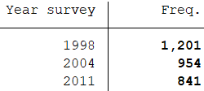
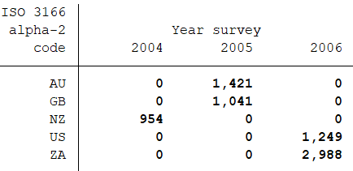
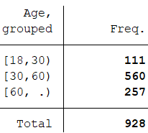

WVS data: comparisons involving NZ
Comparisons of SWB distributions
NZ over time: 1998, 2004, 2011
Sample sizes:
NZ and 4 other countries (wave 5): AU, GB, US, ZA
Sample sizes:
Across groups in NZ (2004): by sex, age group
Sample sizes:

Slide 42
Life Satisfaction over time
Relative frequencies
Dominance checks (levels, inequality)
Inequality indices (selected)
Do you remember your answer to the LS Qn?

Slide 43
Relative frequency distributions for LS, NZ: 1998, 2004, 2011 [nzae10]
Mode and median = 8 in all 3 years
2004 distribution appears to differ from other two, but differences small

Slide 44
LS: CDF comparisons over years, NZ [nzae03]
2004 F-dominates 1998, and 2004 F-dominates 2011 (no result for 2011 and 1998); no S-dominance results at all

Slide 45
LS: C-F dominance? [nzae10]
More unequal: GL curve further from diagonal line
2011 more equal than 1998, and 2004 more equal than 1998 according to all indices CF(γ), but differences very small

Slide 46
LS: H⁺ (lhs) and H– (rhs) dominance? [nzae10]
If curve for year A is everywhere below that for year B (A dominates B), and holds for both H⁺ and H– comparisons, then A is more equal than B
2011 appears more equal than 1998 (but no other dual-dominance results), but difference is very small

Slide 47
LS: Inequality indices (and means) [nzae13]
Point estimates and 95% CIs (bootstrapped SEs, 500 replications)
Inequality point estimates lower for 2004 than both 2011, 1998, except for Abul Naga & Yalcin bottom-sensitive index
But CIs overlap!
Mean is highest in 2004 (and note that SD is distinctly lower for that year)

Slide 48
Life Satisfaction across countries
NZ, AU, GB, US, ZA
WVS wave 5 (mid-2000s)

Slide 49
Relative frequency distributions for LS, across countries [nzae09]
Mode = 8 in all 5 countries. Median = 8 in all countries except ZA (7)
NZ distribution appears to differ from AU, GB, US: relatively large fraction with 10 (cf. ZA similarly, but with relatively high fraction with very low LS)

Slide 50
LS: CDF comparisons across countries [nzae02]
Pairwise comparisons of NZ with each other country
NZ F-dominates AU, US, and ZA (and hence NZ has higher mean, regardless of scale); no S-dominance results at all

Slide 51
LS: C-F dominance? [nzae08]
More unequal: GL curve further from diagonal line
NZ more equal than ZA and more unequal than GB, but differences small

Slide 52
LS: H⁺ (lhs) and H– (rhs) dominance? [nzae08]
If curve for year A is everywhere below that for year B (A dominates B), and holds for both H⁺ and H– comparisons, then A is more equal than B
NZ appears more unequal than GB, but differences small; no other dual-dominance results

Slide 53
LS: Inequality indices (and means) [nzae12]
Point estimates and 95% CIs (bootstrapped SEs, 500 replications)
Inequality distinctly higher in ZA than in each of the other 4 countries
GB inequality point estimate is lowest (depending on index)
NZ inequality point estimates close to those for US
Mean is distinctly high in NZ (and low in ZA)

Slide 54
Life Satisfaction across subgroups within NZ, 2004
By sex and by age group

Slide 55
Relative frequency distributions for LS, across subgroups [nzae11]
Distinct differences by sex, at top and bottom
NB median = 8 for both men and women
Distinct differences by age group: look at those satisfied elders!
NB median for those aged 60+ is 9 but 8 for the two younger groups

Slide 56
LS: CDF comparisons across subgroups [nzae06]
Men-Women: no F-dominance or S-dominance
Age groups: no F-dominance or S-dominance
Subgroup aged 60+ F-dominates from around category 4 and above, but not over the lowest categories

Slide 57
LS: C-F dominance across subgroups? [nzae11]
More unequal: GL curve further from diagonal line
LS distribution for women more unequal than that for men (but differences very small)
No dominance results for age groups
Hence, inequality orderings for age groups may depend on which C-F(γ) index is used

Slide 58
LS: H⁺ (lhs) and H– (rhs) dominance? [nzae11]
If curve for year A is everywhere below that for year B (A dominates B), and holds for both H⁺ and H– comparisons, then A is more equal than B
LS distribution for women is more unequal than that for men (dual dominance)
No dual dominance results for age group comparisons

Slide 59
LS: Inequality indices (and means) [nzae14]
Point estimates and 95% CIs (bootstrapped SEs, 500 replications)
Large SEs make inference difficult (small subgroup sizes, esp. 18–30 year olds)
That said, subgroup rankings appear to vary by inequality index (cf. 60+ year olds)

Slide 60
Self-assessed health status
Brief selection of results
(1998 excluded: 5 point scale rather than 4)
(ZA excluded: 5 point scale rather than 4)

Slide 61
Relative frequency distributions for health status across years, NZ [nzae16]
Very similar for 2004 (left) and 2011 (right)

Slide 62
Inequality indices and means for health status across years, NZ [nzae19]
Point estimates and 95% CIs (bootstrapped SEs, 500 replications)
No change!

Slide 63
Relative frequency distributions for health status across countries [nzae09]
Distinct differences between NZ, AU, GB, US
NB WVS data problem for ZA

Slide 64
Health status: CDF comparisons across countries
Median is ‘good’ (4) in NZ, AU, GB, US
But NZ F-dominates each other country (higher health status at each p)

Slide 65
Inequality indices and means for health status across countries [nzae18]
Inequality distinctly larger in GB
Inequality lowest in US (but note overlapping CIs)
NZ more unequal than US (but note overlapping CIs), but higher mean

Slide 66
Relative frequency distributions for health status across NZ subgroups [nzae17]
Some differences between men and women, and 60+ versus other age groups

Slide 67
Inequality indices and means for health status across NZ subgroups [nzae20]
No significant inequality differences between men and women
Inequality-age gradient depends on which inequality index is used, but note large SEs

Slide 68
5. Concluding remarks

Slide 69
(a) Analysis matters
Don’t apply methods for cardinal data to ordinal SWB data
There’s now a well-developed (and growing) ‘toolbox’ for undertaking distributional comparisons of SWB data
For SWB levels and (less commonly-studied) SWB inequality
For ‘showing the data’ and dominance checks, and for summary indices of inequality
Analytical challenges remain, e.g.
Combining levels and (in)equality in an overall assessment
Combining information across SWB dimensions
Only life satisfaction and self-assessed health here; many more in the Living Standards Framework and OECD dashboard of indicators
Don’t throw away income distribution comparisons!

Slide 70
(b) Suggestive findings
According to WVS data:
The distribution of Life Satisfaction in NZ changed little between 1998 and 2011
NZ has high LS levels relative to AU, US, ZA, but has more LS inequality than AU and US (but not ZA)
Patterns for health status differ from those for life satisfaction
Comparisons of SWB across subgroups within a population are bedevilled by small sample sizes (large SEs)
Which underlines that looking at SEs is important
Dominance checks are often not clear cut (curves intersect), but they are valuable for showing the data as well
Show and compare CDFs especially (and relative frequencies)

Slide 71
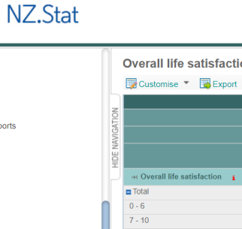
(c) NZ-specific challenges to SWB analysis?
Large(r) sample sizes required for analysis of population subgroups (e.g. Māori and Pasifika)
General Social Survey
Te Kupenga (Māori-specific GSS)
But note differences in LS scales (5-point versus 11-point), so work to align them in common format
Household Economic Survey: recently-announced expansion to sample size for measuring child poverty; add some SWB questions?
Improve access for outside researchers to CURFs: there must be a better way than at present to provide valuable data while respecting confidentiality (cf. UK experience)
Improve NZ.Stat webtool: it seems odd to group GSS LS categories into only two (0–6, 7–10)!
Use the ‘toolbox’ items discussed here in analysis and reports

